Slide 1


Seattle Seahawks Scheduling Problem
Presented by Team 10:
Gautami Edara
Cristina Esposito
Nathan Murstein
Hisham Salem

Slide 2
Agenda
Intro
Problem Description
Numerical Implementation
Problem Extension
Conclusion

Slide 3

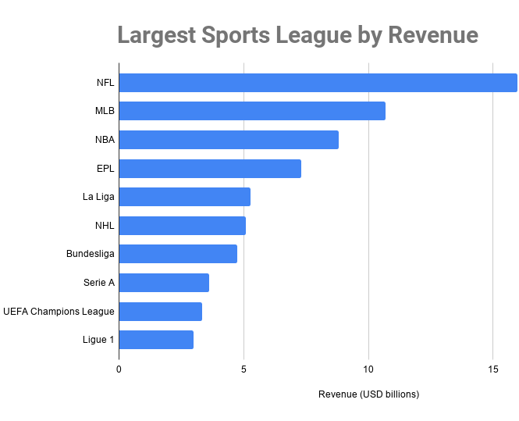
$13 billion
7.3 million
NFL revenue in 2020
mean game viewership in 2021

Slide 4
National Football League
National Football League - NFL
National Football Conference - NFC
American Football Conference- AFC
North
South
East
West
North
South
East
West
4 Teams
4 Teams
4 Teams
4 Teams
4 Teams
4 Teams
4 Teams
4 Teams

Slide 5

Scope
NFL uses integer programming to create the schedule since 2013
This is considered an incredibly complex and scrutinized problem
Challenges:
824 trillion game combinations
Takes the NFL 12 weeks each year to create the schedule
Goal: determine season schedule (game days, opponents, bye-week) for the Seattle Seahawks.
Objective function variations:
Maximize game value (expected revenue)
Maximize viewership
Maximize fairness
Minimize travel costs
And more…
Thousands of constraints (and increasing)
Stadium availability
Travel considerations
Competitive equity
Internal rules

Slide 6
Week / Day | Monday | Tuesday | Wednesday | Thursday | Friday | Saturday | Sunday | Team
1 | ? | ? | ? | ? | ? | ? | ? | ?
2 | ? | ? | ? | ? | ? | ? | ? | ?
3 | ? | ? | ? | ? | ? | ? | ? | ?
4 | ? | ? | ? | ? | ? | ? | ? | ?
5 | ? | ? | ? | ? | ? | ? | ? | ?
6 | ? | ? | ? | ? | ? | ? | ? | ?
7 | ? | ? | ? | ? | ? | ? | ? | ?
8 | ? | ? | ? | ? | ? | ? | ? | ?
9 | ? | ? | ? | ? | ? | ? | ? | ?
10 | ? | ? | ? | ? | ? | ? | ? | ?
11 | ? | ? | ? | ? | ? | ? | ? | ?
12 | ? | ? | ? | ? | ? | ? | ? | ?
13 | ? | ? | ? | ? | ? | ? | ? | ?
14 | ? | ? | ? | ? | ? | ? | ? | ?
15 | ? | ? | ? | ? | ? | ? | ? | ?
16 | ? | ? | ? | ? | ? | ? | ? | ?
17 | ? | ? | ? | ? | ? | ? | ? | ?
18 | ? | ? | ? | ? | ? | ? | ? | ?

Slide 7
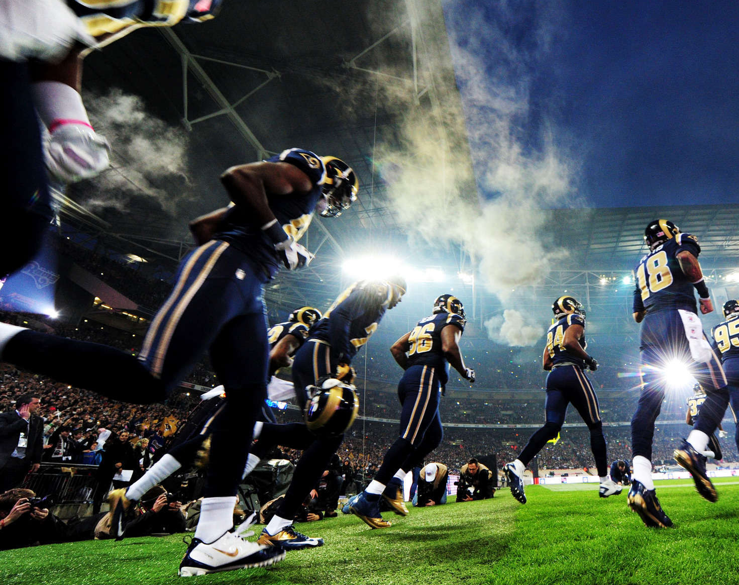
Problem Formulation

Slide 8
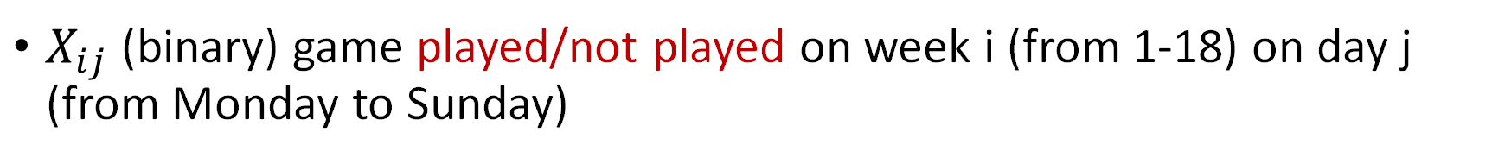
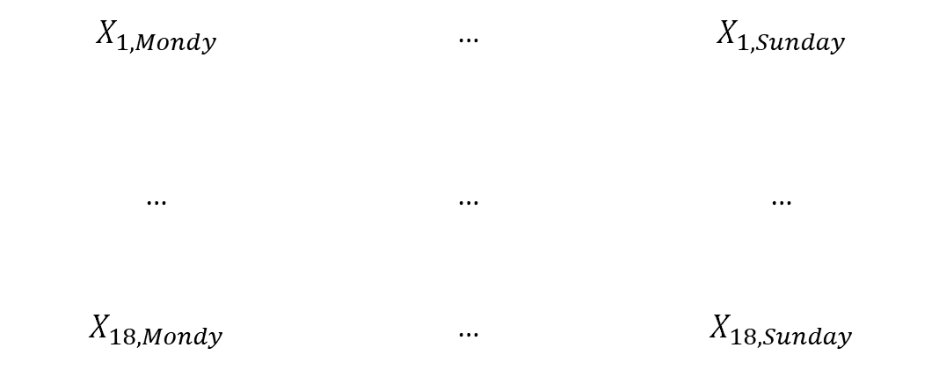
Decision Variables
$X_{ij}$ (binary) game played/not played on week i (from 1-18) on day j (from Monday to Sunday)
Monday
…
Sunday
Week 1
$X_{1,Mondy}$ | … | $X_{1,Sunday}$
… | … | …
$X_{18, Mondy}$ | … | $X_{18,Sunday}$
…
Week 18

Slide 9
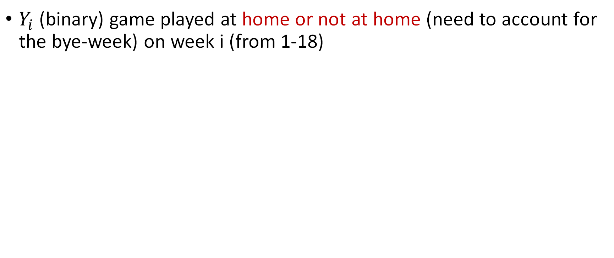
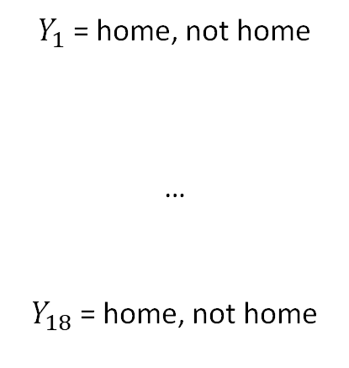
Decision Variables
$Y_{i}$ (binary) game played at home or not at home (need to account for the bye-week) on week i (from 1-18)
Week 1
$Y_{1}$ = home, not home
…
$Y_{18}$ = home, not home
…
Week 18

Slide 10
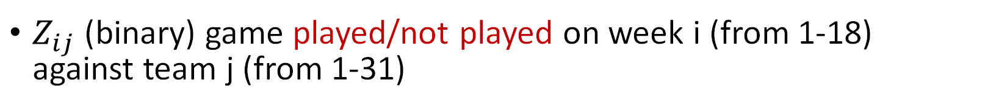
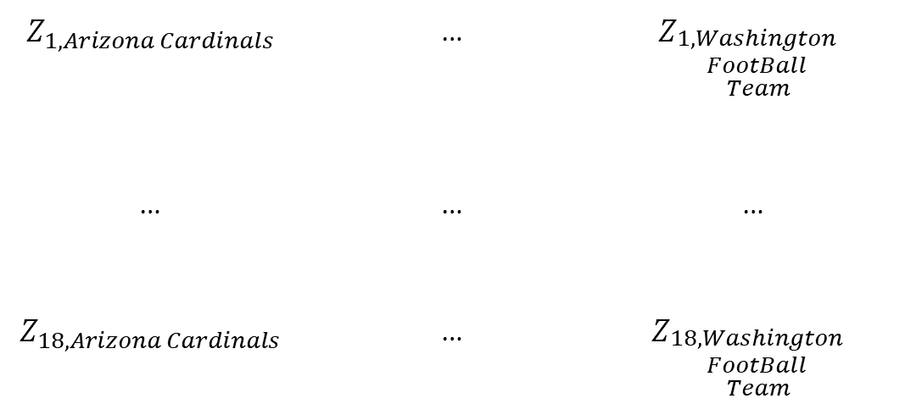
Decision Variables
$Z_{ij}$ (binary) game played/not played on week i (from 1-18) against team j (from 1-31)
Arizona Cardinals
…
Washington Football Team
Week 1
$Z_{1,Arizona Cardinals}$ | … | $$Z_{\begin{aligned}1,Washington \\ FootBall \\ Team\end{aligned}}$$
… | … | …
$Z_{18,Arizona Cardinals}$ | … | $$Z_{\begin{aligned}18,Washington \\ FootBall \\ Team\end{aligned}}$$
…
Week 18

Slide 11
Decision Variables
Ni (integer) total number of games played in the NFC division i (North, East, South)
Ai (integer) total number of games played in the AFC division i (North, East, South, West)
Ti (binary) dummy variable for Ni games (1-3)
Si (binary) dummy variable for Ai games (1-4)

Slide 12


Objective Function
Objective - Maximize the number of games in a regular season to generate the schedule
$$\sum{X_{ij}}$$

Slide 13
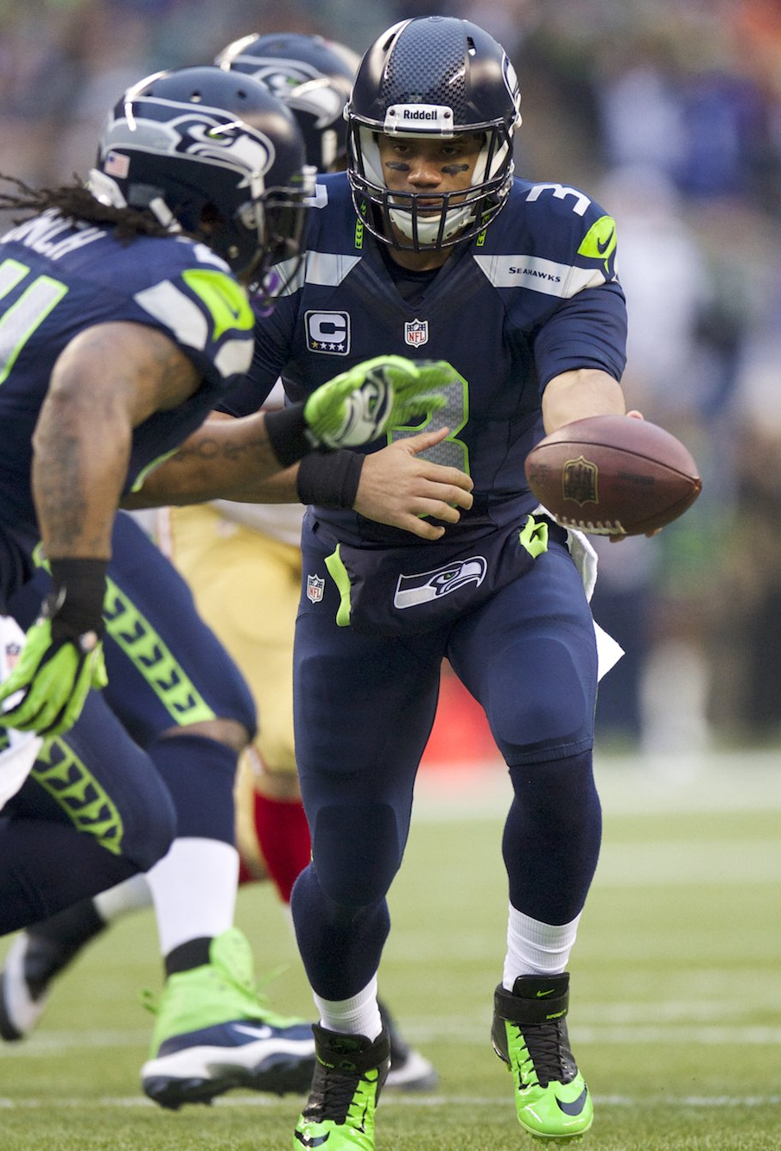
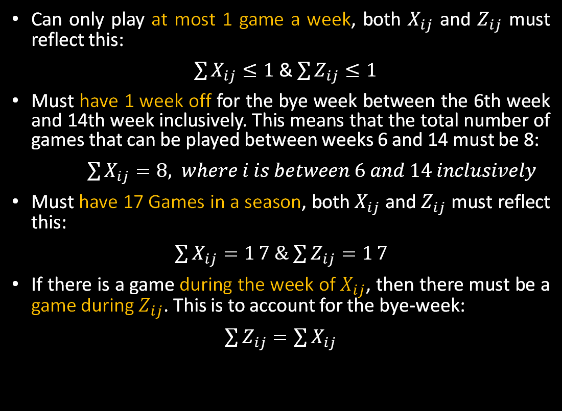
Constraints – Number of games
Can only play at most 1 game a week, both $X_{ij}$ and $Z_{ij}$ must reflect this:
$\sum{X_{ij}≤1}$ & $\sum{Z_{ij}≤1}$
Must have 1 week off for the bye week between the 6th week and 14th week inclusively. This means that the total number of games that can be played between weeks 6 and 14 must be 8:
$\sum{X_{ij}=8, where i is between 6 and 14 inclusively}$
Must have 17 Games in a season, both $X_{ij}$ and $Z_{ij}$ must reflect this:
$\sum{X_{ij}=1}7$ & $\sum{Z_{ij}=1}7$
If there is a game during the week of $X_{ij}$, then there must be a game during $Z_{ij}$. This is to account for the bye-week:
$\sum{Z_{ij}=\sum{X_{ij}}}$

Slide 14

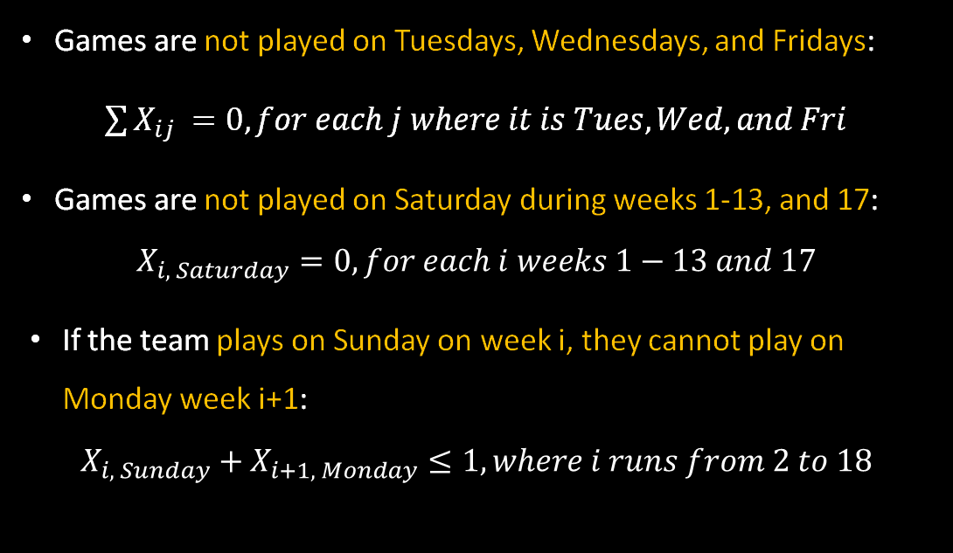
Constraints – Days of the week
Games are not played on Tuesdays, Wednesdays, and Fridays:
$\sum{X_{ij}} =0,for each j where it is Tues, Wed, and Fri$
Games are not played on Saturday during weeks 1-13, and 17:
$$X_{i, Saturday}=0, for each i weeks 1−13 and 17$$
If the team plays on Sunday on week i, they cannot play on Monday week i+1:
$$X_{i, Sunday}+X_{i+1, Monday}≤1, where i runs from 2 to 18$$

Slide 15
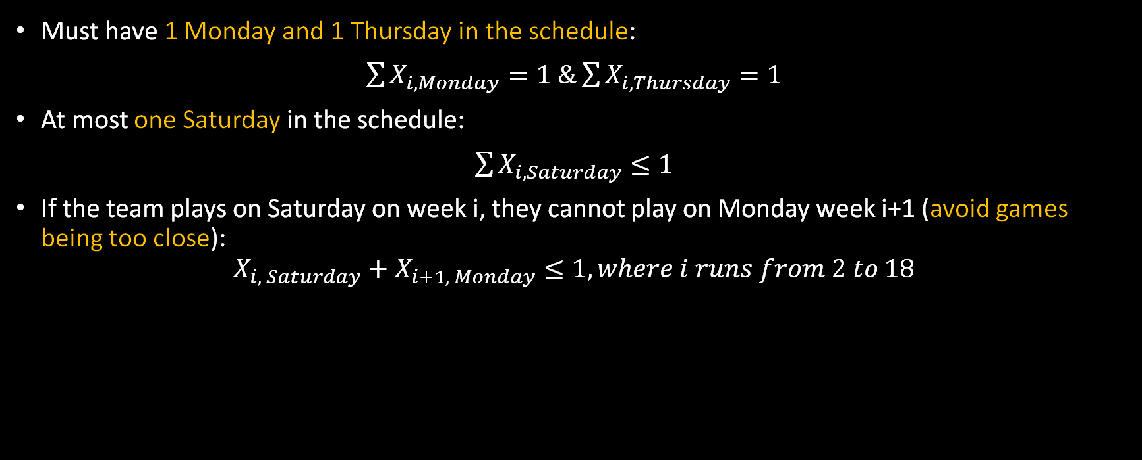
Constraints – Days of the week (Cont.)
Must have 1 Monday and 1 Thursday in the schedule:
$\sum{X_{i,Monday}}=1 \&\sum{X_{i,Thursday}}=1$
At most one Saturday in the schedule:
$\sum{X_{i,Saturday}}≤1$
If the team plays on Saturday on week i, they cannot play on Monday week i+1 (avoid games being too close):
$$X_{i, Saturday}+X_{i+1, Monday}≤1, where i runs from 2 to 18$$

Slide 16
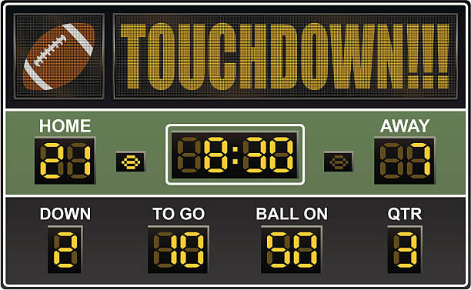
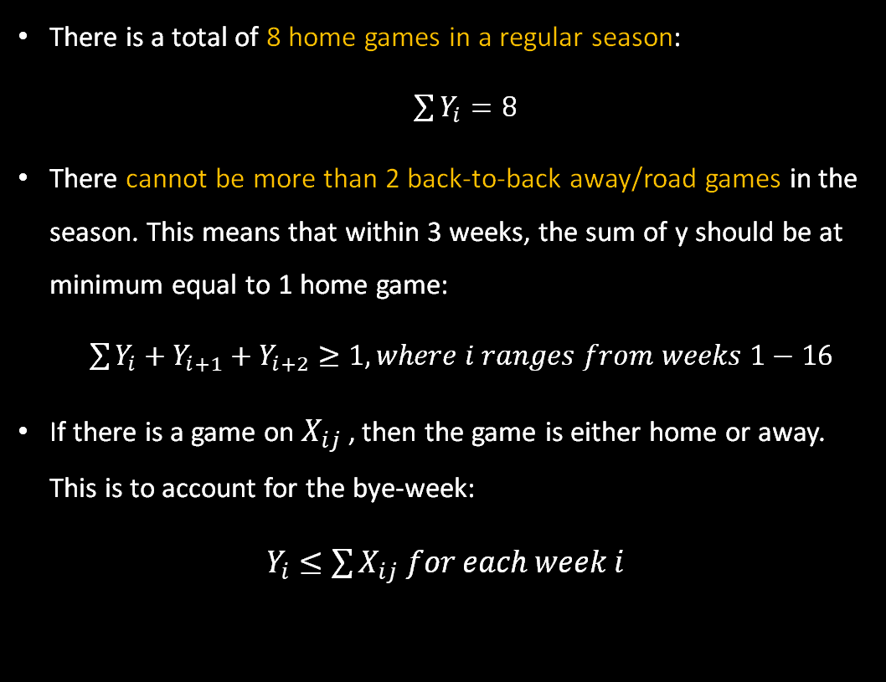
Constraints – Home/Away Games
There is a total of 8 home games in a regular season:
$\sum{Y_{i}}=8$
There cannot be more than 2 back-to-back away/road games in the season. This means that within 3 weeks, the sum of y should be at minimum equal to 1 home game:
$\sum{Y_{i}+Y_{i+1}+Y_{i+2}}≥1, where i ranges from weeks 1−16$
If there is a game on $X_{ij}$ , then the game is either home or away. This is to account for the bye-week:
$Y_{i}≤\sum{X_{ij} for each week i}$

Slide 17






Constraints – Divisions and Conferences
Must have 2 games per team in the same division (NFC West):
$$\sum{Z_{i, Arizona Cardinals}=} 2$$
$$\sum{Z_{i, LA Rams}=} 2$$
$$\sum{Z_{i, San Francisco 49ers}=} 2$$
Notes:
Thanks Hisham. Lastly we have constraints regarding playing specific divisions within the two conferences in the nfl. The first set of constraints require seattle to play 2 games against each team in their own division. In other words, 2 games against the Arizona cardinals, LA rams, and the 49ers respectively.

Slide 18






Constraints – Divisions and Conferences
Must have 6 games against the 3 remaining divisions in their conference. Can’t play the same team more than once. 4 must be with 1 division. 2 must be against a team from each of the 2 other divisions:
$$N_{North}+N_{East}+N_{South}=6$$
$$\sum{Z_{ij}}=N_{North}, where the j is the$$
$$North division teams$$
$$\sum{Z_{ij}}=N_{East}, where the j is the$$
$$East division teams$$
$$\sum{Z_{ij}}=N_{South}, where j is the$$
$$South division teams$$
Notes:
Next, Seattle must play a total of 6 games against the 3 remaining divisions that are within their conference. The total number of games to be played in each division must be equal to the sum of zij games that correspond to the teams in their division.

Slide 19

Constraints – Divisions and Conferences
Must have 6 games against the 3 remaining divisions in their conference. Can’t play the same team more than once. 4 must be with 1 division. 2 must be against a team from each of the 2 other divisions:
$\sum{Z_{ij}}≤1, where j is the North, South, and East division teams for each i week 1−18$
Notes:
Next, Seattle can’t play the same team in these three divisions more than once.

Slide 20
Constraints – Divisions and Conferences
Must have 6 games against the 3 remaining divisions in their conference. Can’t play the same team more than once. 4 must be with 1 division. 2 must be against a team from each of the 2 other divisions:
1 |  | 1 |  | 4
1 |  | 4 |  | 1
4 |  | 1 |  | 1
Notes:
Lastly, there is a specific combinations of games that need to be played with each of these division for it to be equal to the 6 games. Specifically, 1 division needs to have 4 games, and the two remaining divisions need to have 1 game each. In other words, there are 3 possible combinations that can happen with this 4-1-1 pairing.

Slide 21

Constraints – Divisions and Conferences
Must have 6 games against the 3 remaining divisions in their conference. Can’t play the same team more than once. 4 must be with 1 division. 2 must be against a team from each of the 2 other divisions:
$N_{North}=1∗t_{1}+1∗t_{2}+4∗t_{3}$
$N_{East}=1∗t_{1}+4∗t_{2}+1∗t_{3}$
$N_{South}=4∗t_{1}+1∗t_{2}+1∗t_{3}$
$t_{1}+t_{2}+t_{3}=1$
“N possible values” method
Notes:
In order to formulate this mathematically, we decided to use the N possible values method. This requires that we have 3 dummy variables, in this case t, that represent each of the 3 combinations. The sum of these values must be equal to 1, since we only want 1 combination to be exist. For example, let’s say t1 is equal to 1, this would mean that the north and east division will get 1 game, and the south division will get 4 games.

Slide 22
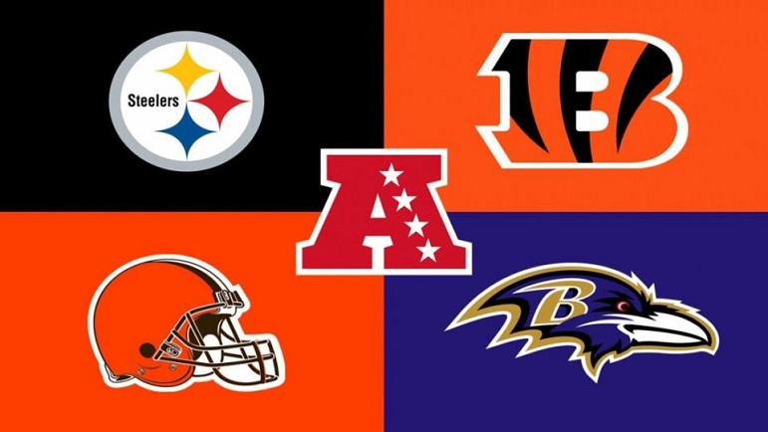
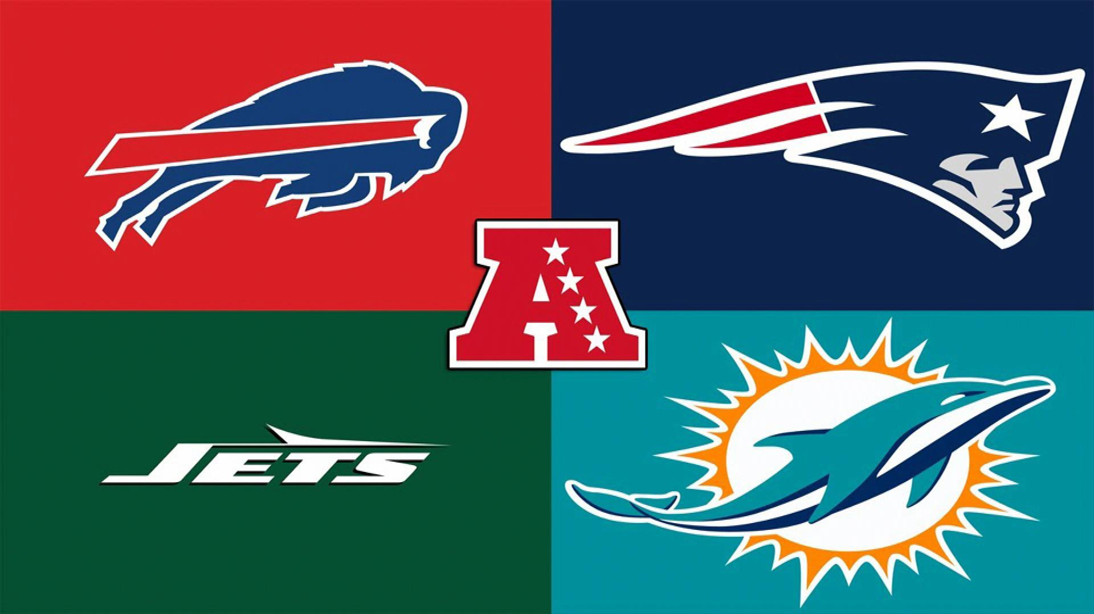

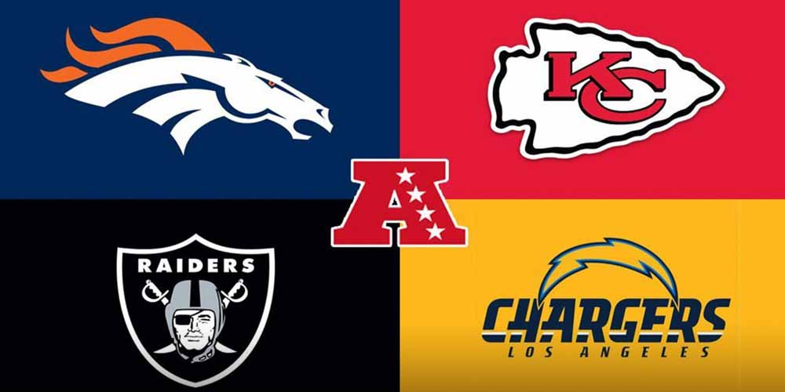





Constraints – Divisions and Conferences
Must have 5 games against divisions in the other conference (AFC). Cannot play the same team more than once. 4 games must be with 1 division and 1 game from any other division:
$A_{North}+A_{East}+A_{South}+A_{West}$ = 5
$$\sum{Z_{ij}}=A_{North}, where j$$
$$is the AFC North teams$$
$$\sum{Z_{ij}}=A_{East}, where j$$
$$is the AFC East teams$$
$$\sum{Z_{ij}}=A_{South}, where j$$
$$is the AFC South teams$$
$$\sum{Z_{ij}}=A_{West}, where j$$
$$is the AFC West teams$$
Notes:
Next up, we have a similar scenario but with divisions in the AFC. First up, the total number of games to be played with these 4 divisions must be 5 and the total number of games to be played in each division must be equal to the sum of zij games that correspond to the teams in their division.

Slide 23
Constraints – Divisions and Conferences
Must have 5 games against divisions in the other conference (AFC). Cannot play the same team more than once. 4 games must be with 1 division and 1 game from any other division:
$$\sum{Z_{ij}}≤1, where j is all the teams in the AFC for each i week 1−18$$
Notes:
Next we have the same self-explanatory constraint that makes it so that seattle can only play at most 1 game against each of these teams.

Slide 24
Constraints – Divisions and Conferences
Must have 5 games against divisions in the other conference (AFC). Cannot play the same team more than once. 4 games must be with 1 division and 1 game from any other division:
Many combinations with 4 divisions and 4 possible outcomes for each division
Notes:
And lastly, there has to be a specific combination of games that need to be played with each of these division for it to be equal to 5. Specifically, 1 division must have 4 games, another division will have 1 game, and the 2 remaining divisions will have no games.

Slide 25

Constraints – Divisions and Conferences
Must have 5 games against divisions in the other conference (AFC). Cannot play the same team more than once. 4 games must be with 1 division and 1 game from any other division:
$A_{North}≥4−M∗S_{1}$
$A_{East}≥4−M∗S_{2}$
$A_{South}≥4−M∗S_{3}$
$A_{West}≥4−M∗S_{4}$
$S_{1}+S_{2}+S_{3}+S_{4}=3$
“Big M” method to determine which division will get the 4 games
Notes:
Since this scenario will lead to more possible combinations than the previous scenario, we decided to apply the big M method to help us determine which division will get the 4 games. This requires that we have 4 dummy variables, in this case S, that when summed together, must equal to 3. This is because we want only 1 constraint to be selected as identifying the division to get the 4 games. For example, say S1,2, and 3 are all 1 and S4 is 0, this would mean that the only valid constraint would point to the AFC west division having the 4 games.

Slide 26
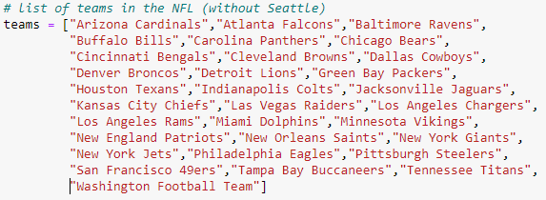
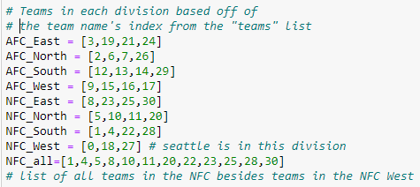
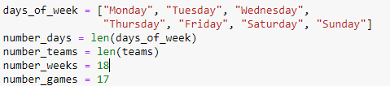
Numerical Implementation and Results
Data we are using is from NFL Website
To formulate the model, we have declared the variables and stored the following details –
Created lists to store the names of 31 teams excluding Seattle Seahawks
We have two conferences – AFC, NFC
Each conference has 4 divisions – AFC North, AFC South, AFC West, AFC East and NFC North, NFC South, NFC East and NFC West
Each division has 4 teams except for NFC West which has only 3 as Seattle Seahawks is part of it
Day of the week – Monday, Tuesday, Wednesday… Sunday
Total game weeks – 18
Total games – 17
Notes:
Now we will see the modeling part, here we have taken data from the NFL website. We have created lists to store the names of 31 teams excluding Seattle Seahawks. We have lists created for AFC and NFC which have 4 divisions each AFC north, south, east and west similarly we have for NFC.. Each division contains 4 teams except for NFC_west as seattle seahawks is part of this division. We have variables like total number of weeks, days of week, total number of games. Then we create objective function and add constraints. Next slide

Slide 27
Model Results
Week / Day | Monday | Tuesday | Wednesday | Thursday | Friday | Saturday | Sunday | Team
1 |  |  |  |  |  |  | Home Game | Los Angeles Rams
2 |  |  |  |  |  |  | Away Game | Arizona Cardinals
3 |  |  |  | Away Game |  |  |  | Tampa Bay Buccaneers
4 | Home Game |  |  |  |  |  |  | Cincinnati Bengals
5 |  |  |  |  |  |  | Away Game | Los Angeles Rams
6 |  |  |  |  |  |  | Home Game | Green Bay Packers
7 |  |  |  |  |  |  | Home Game | Kansas City Chiefs
8 | BYE WEEK
9 |  |  |  |  |  |  | Away Game | Las Vegas Raiders
10 |  |  |  |  |  |  | Home Game | Atlanta Falcons
11 |  |  |  |  |  |  | Home Game | San Francisco 49ers
12 |  |  |  |  |  |  | Away Game | Washington Football Team
13 |  |  |  |  |  |  | Home Game | San Francisco 49ers
14 |  |  |  |  |  |  | Away Game | Arizona Cardinals
15 |  |  |  |  |  |  | Away Game | New Orleans Saints
16 |  |  |  |  |  |  | Home Game | Los Angeles Chargers
17 |  |  |  |  |  |  | Away Game | Carolina Panthers
18 |  |  |  |  |  |  | Away Game | Denver Broncos
Notes:
The objective of the Model 1 was to maximize the number of games. This was out final output where you can see total games played are 17 and as explained by Hisham and Cristina all constraints are met and all NFC game scheduling rules are being followed. For example, only one game can be played per week and as you see there is only 1 game scheduled in a week. 1 week must be a bye week between week 6 and 14 and week 8 is bye week for seattle seahawks. If a game is being played on Saturday or Sunday then there will be no game scheduled for coming Monday. So all the rules are being followed appropriately. Lets see the problem extension.. Over to you Nathan.

Slide 28




As mentioned before, there are multiple ideas out there of what to use as an objective function for this type of problem:
Objective function variations:
Maximize game value (expected revenue)
Maximize viewership
Maximize fairness
Minimize travel costs
And more…
Of the $13 billion in annual revenue, broadcasting contracts make up over 50% of all revenue
Therefore, league earnings should vary based on TV viewership
Extension: maximize game value, using past viewership as proxy.
Objective = $\sum{X_{ij}{viewership}_{ij}}$

Slide 29
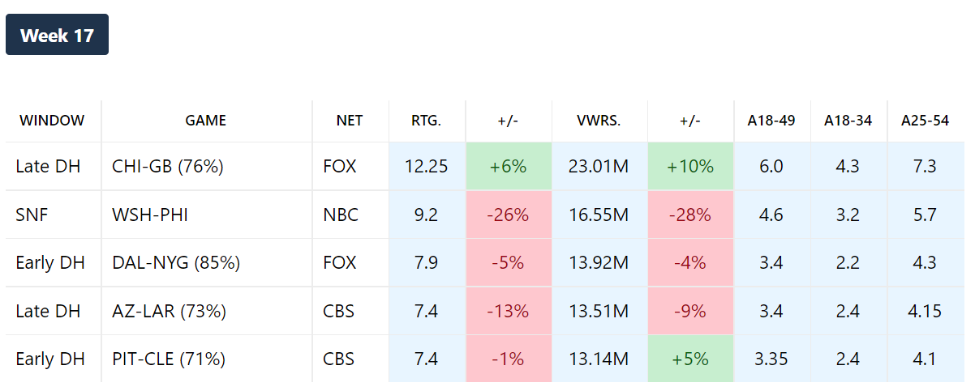
Data Gathering
We looked at past viewership for games on each day of the week in each week of the season, aggregated for all teams.
Sunday games are typically the most viewed, with the exception of holiday games
Tradeoff: Seahawks specific data vs. complete data
Future extensions: account for excluded variables

Slide 30
Model Results: Initial Formulation
Week / Day | Monday | Tuesday | Wednesday | Thursday | Friday | Saturday | Sunday | Team
1 |  |  |  |  |  |  | Home Game | Los Angeles Rams
2 |  |  |  |  |  |  | Away Game | Arizona Cardinals
3 |  |  |  | Away Game |  |  |  | Tampa Bay Buccaneers
4 | Home Game |  |  |  |  |  |  | Cincinnati Bengals
5 |  |  |  |  |  |  | Away Game | Los Angeles Rams
6 |  |  |  |  |  |  | Home Game | Green Bay Packers
7 |  |  |  |  |  |  | Home Game | Kansas City Chiefs
8 | BYE WEEK
9 |  |  |  |  |  |  | Away Game | Las Vegas Raiders
10 |  |  |  |  |  |  | Home Game | Atlanta Falcons
11 |  |  |  |  |  |  | Home Game | San Francisco 49ers
12 |  |  |  |  |  |  | Away Game | Washington Football Team
13 |  |  |  |  |  |  | Home Game | San Francisco 49ers
14 |  |  |  |  |  |  | Away Game | Arizona Cardinals
15 |  |  |  |  |  |  | Away Game | New Orleans Saints
16 |  |  |  |  |  |  | Home Game | Los Angeles Chargers
17 |  |  |  |  |  |  | Away Game | Carolina Panthers
18 |  |  |  |  |  |  | Away Game | Denver Broncos

Slide 31
Model Results: New Formulation
Week / Day | Monday | Tuesday | Wednesday | Thursday | Friday | Saturday | Sunday | Team
1 |  |  |  |  |  |  | Home Game | Baltimore Ravens
2 |  |  |  |  |  |  | Home Game | Los Angeles Rams
3 |  |  |  |  |  |  | Away Game | Arizona Cardinals
4 |  |  |  |  |  |  | Away Game | Atlanta Falcons
5 |  |  |  |  |  |  | Home Game | Los Angeles Rams
6 | BYE WEEK
7 |  |  |  |  |  |  | Home Game | Tennessee Titans
8 |  |  |  |  |  |  | Away Game | Green Bay Packers
9 |  |  |  |  |  |  | Away Game | Carolina Panthers
10 |  |  |  |  |  |  | Home Game | San Francisco 49ers
11 |  |  |  |  |  |  | Home Game | Washington Football Team
12 |  |  |  | Away Game |  |  |  | Tampa Bay Buccaneers
13 | Away Game |  |  |  |  |  |  | San Francisco 49ers
14 |  |  |  |  |  |  | Home Game | Pittsburgh Steelers
15 |  |  |  |  |  |  | Away Game | Arizona Cardinals
16 |  |  |  |  |  |  | Away Game | New Orleans Saints
17 |  |  |  |  |  |  | Home Game | Cleveland Browns
18 |  |  |  |  |  |  | Away Game | Cincinnati Bengals

Slide 32
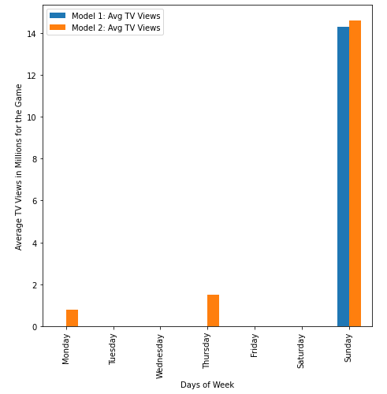
Comparison of Television Views : Model 1 Vs Model 2

Slide 33
Recommendations and Conclusions
Scheduling was feasible for a single team and using given constraints
Scheduling was made at the league level and not at team level
Replicating it to other 31 teams will increase the complexity and the constraints involved.
Extrapolating this design for the league would be difficult and would require more time.
Notes:
In our project, the scheduling was formulated, and it was feasible for a specific team. Similarly, if we need to provide a schedule for any other team, it can be achieved.
If we try to achieve the same at league level, we need to consider all the 32 teams and their schedule based on the timings of each game which will increase the complexity and number of constraints given the time limitations for this project. Hence, we considered scheduling for 1 team.
Overall, it was nice working on the base problem and its extension using the TV viewership. Hope you liked the presentation. Thank You!

Slide 34
THANK YOU!

